Slide 1
Multi Cloud SLA

Slide 2
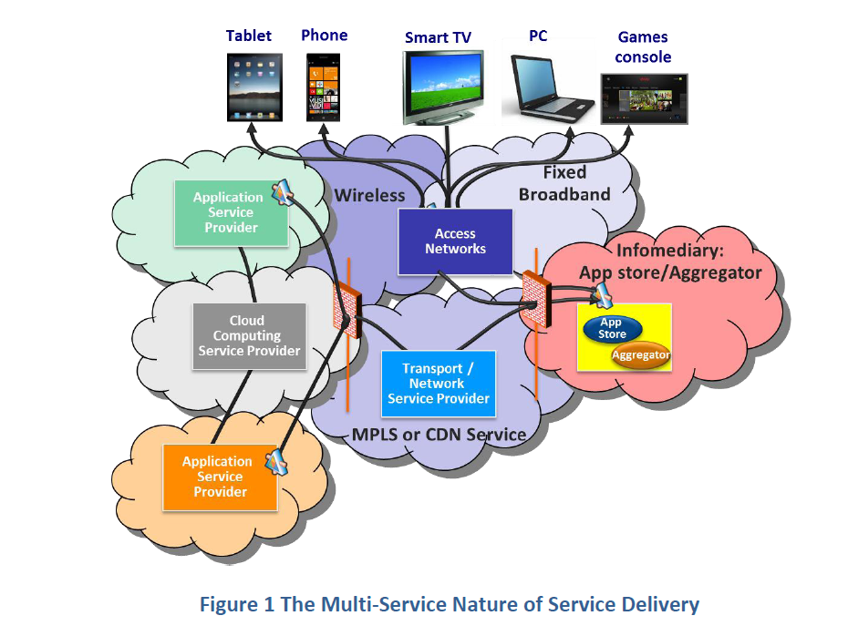
Nature of service delivery

Slide 3
WHY SLA
Critical real world challenges needs to be addressed for operators to achieve excellecne in deploying and operating services realized by multiple interconnected cloud services
An operational view on E2E Service Level Management
The management capabilities needed to define monitor and maintained service level guarantees across cloud deployments.

Slide 4
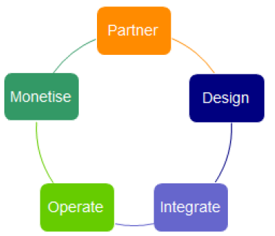
Digital Service Life Cycle view

Slide 5
Digital life cycle delivered
Business Models
Process operated between partners
Product and services offered by one partner to another
Contents of a service level agreement amongst the partners

Slide 6
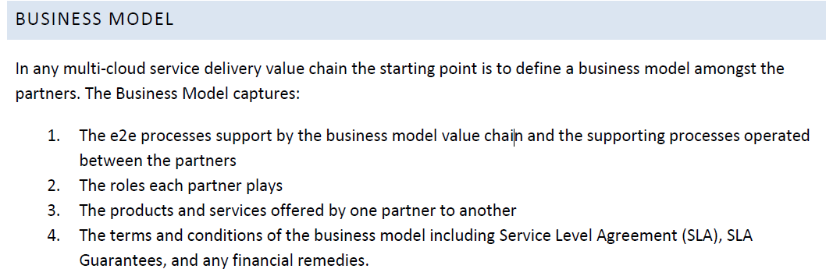

Slide 7
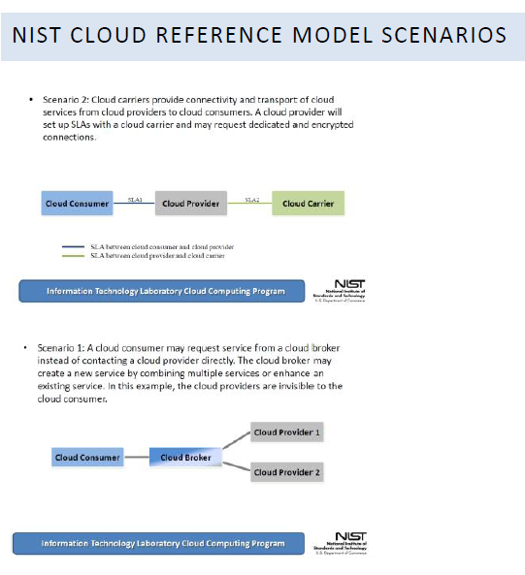

Slide 8
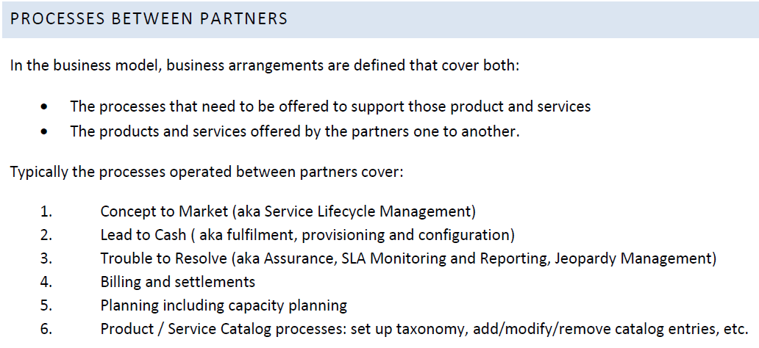

Slide 9
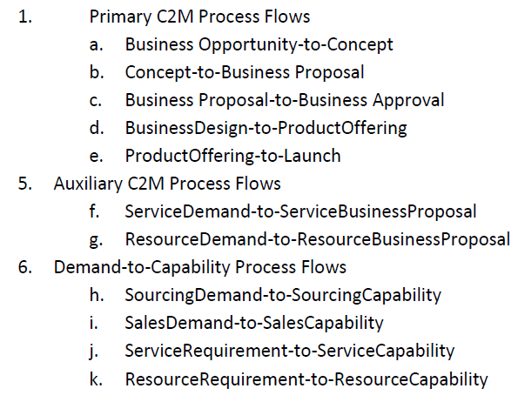
Concept to Market

Slide 10
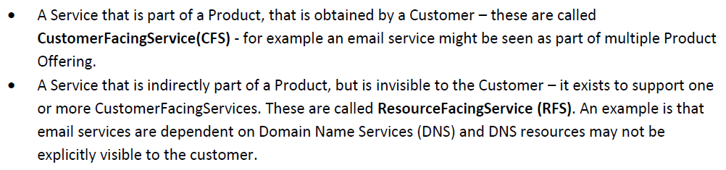
Customer facing service vs Resource facing service ( CFS vs. RFS)

Slide 11
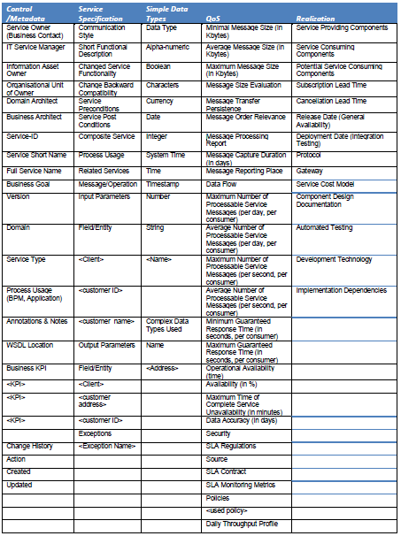
Service Template

Slide 12
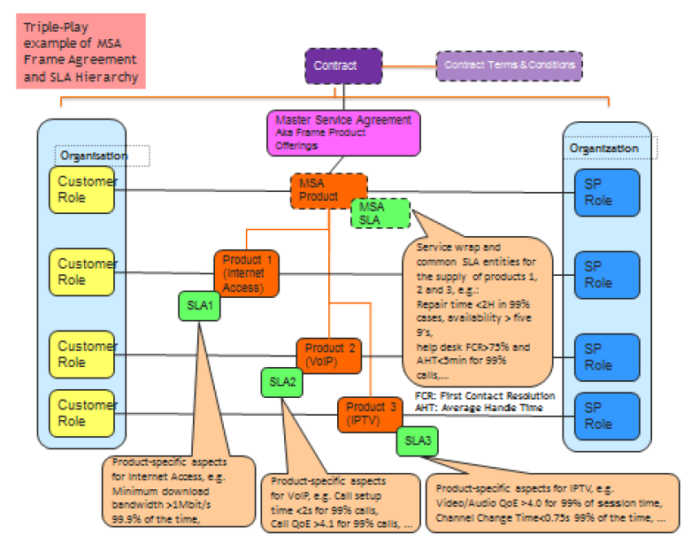
SLA and SLS for Multi Product

Slide 13
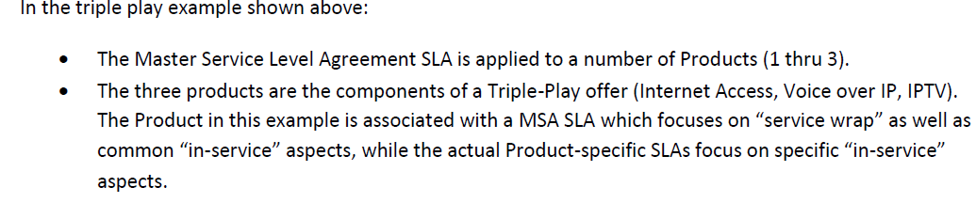
Contd.

Slide 14
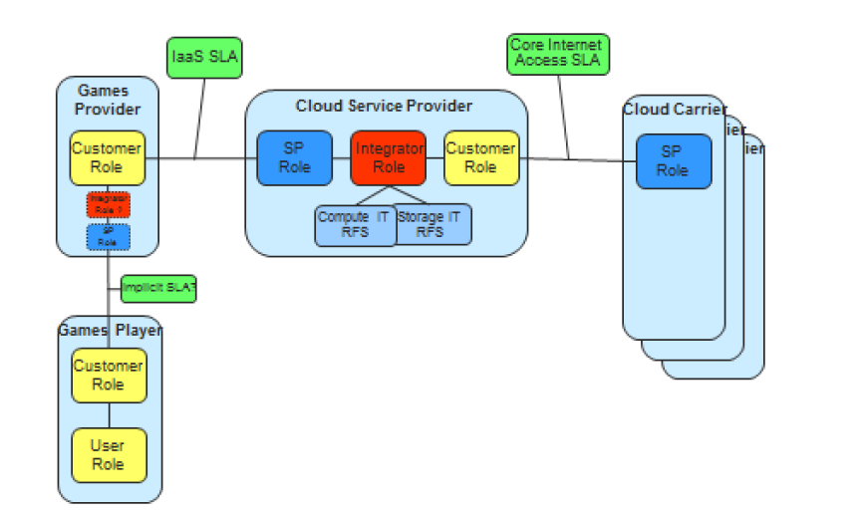
E2E cloud SLA

Slide 15
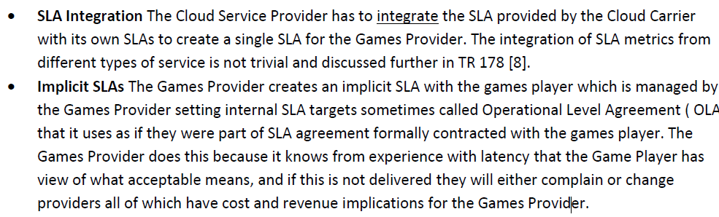

Slide 16
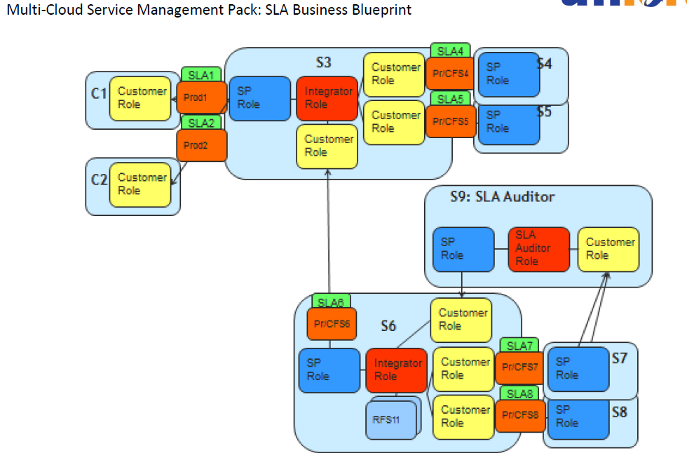

Slide 17
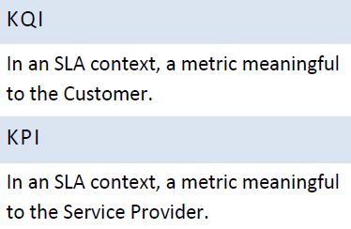
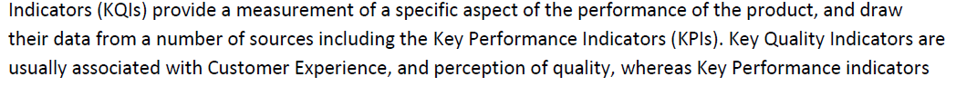
KQI and KPI

Slide 18
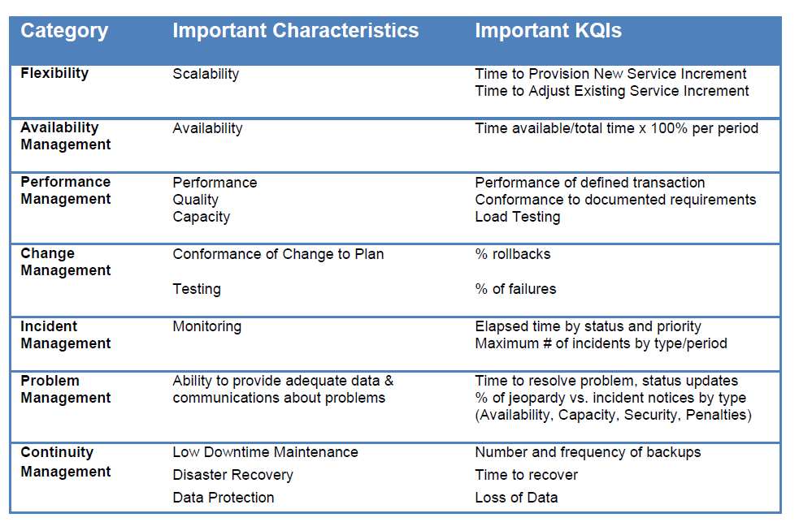
KQI example

